Slide 1
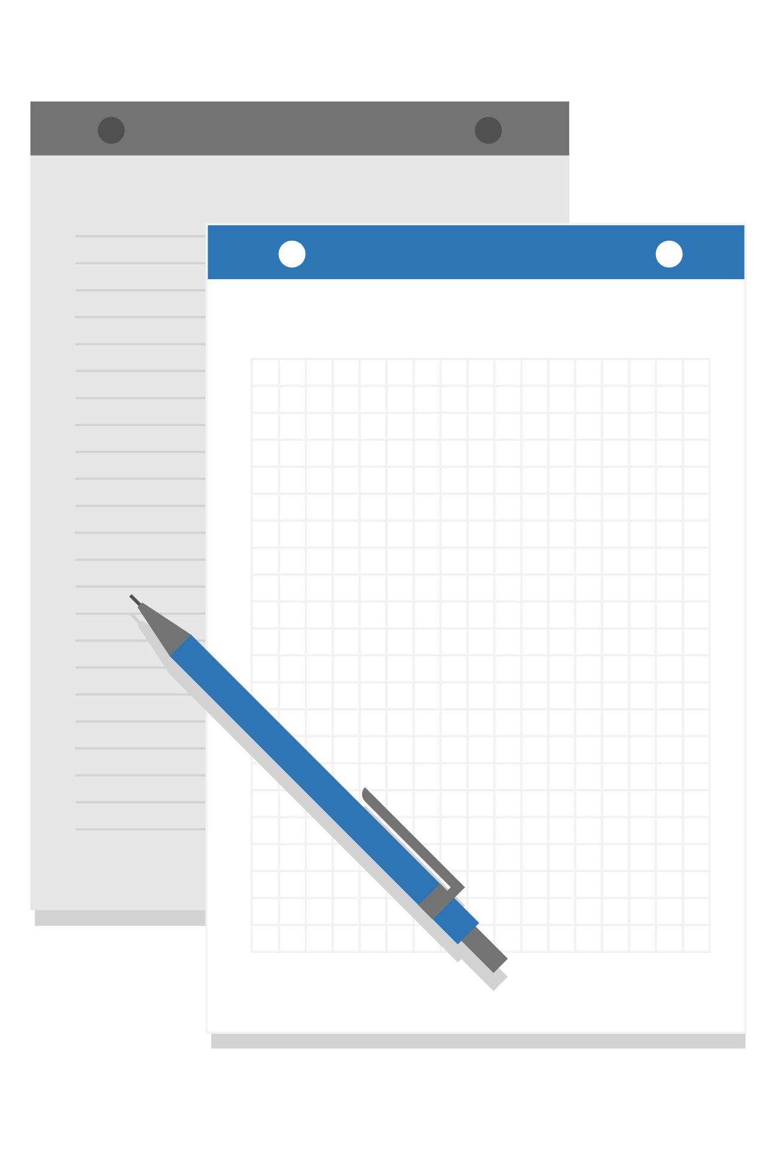
Audio Signal Processing App GUI in Python
Prepared by [Abd Elrahman Shalaby & Abd Elrahman Elsharabsy]
Supervised by [DR.Eslam Shalan]

Slide 2
Application Roadmap
Q1
Q2
Q3
Q4
IDEA
PLANING
EXCUTION
PUBLISHING
How The Project Idea Came To Us
Divide Tasks Among Us Both
Coding The App And Fixing Bugs
Putting It All Together On GitHub

Slide 3
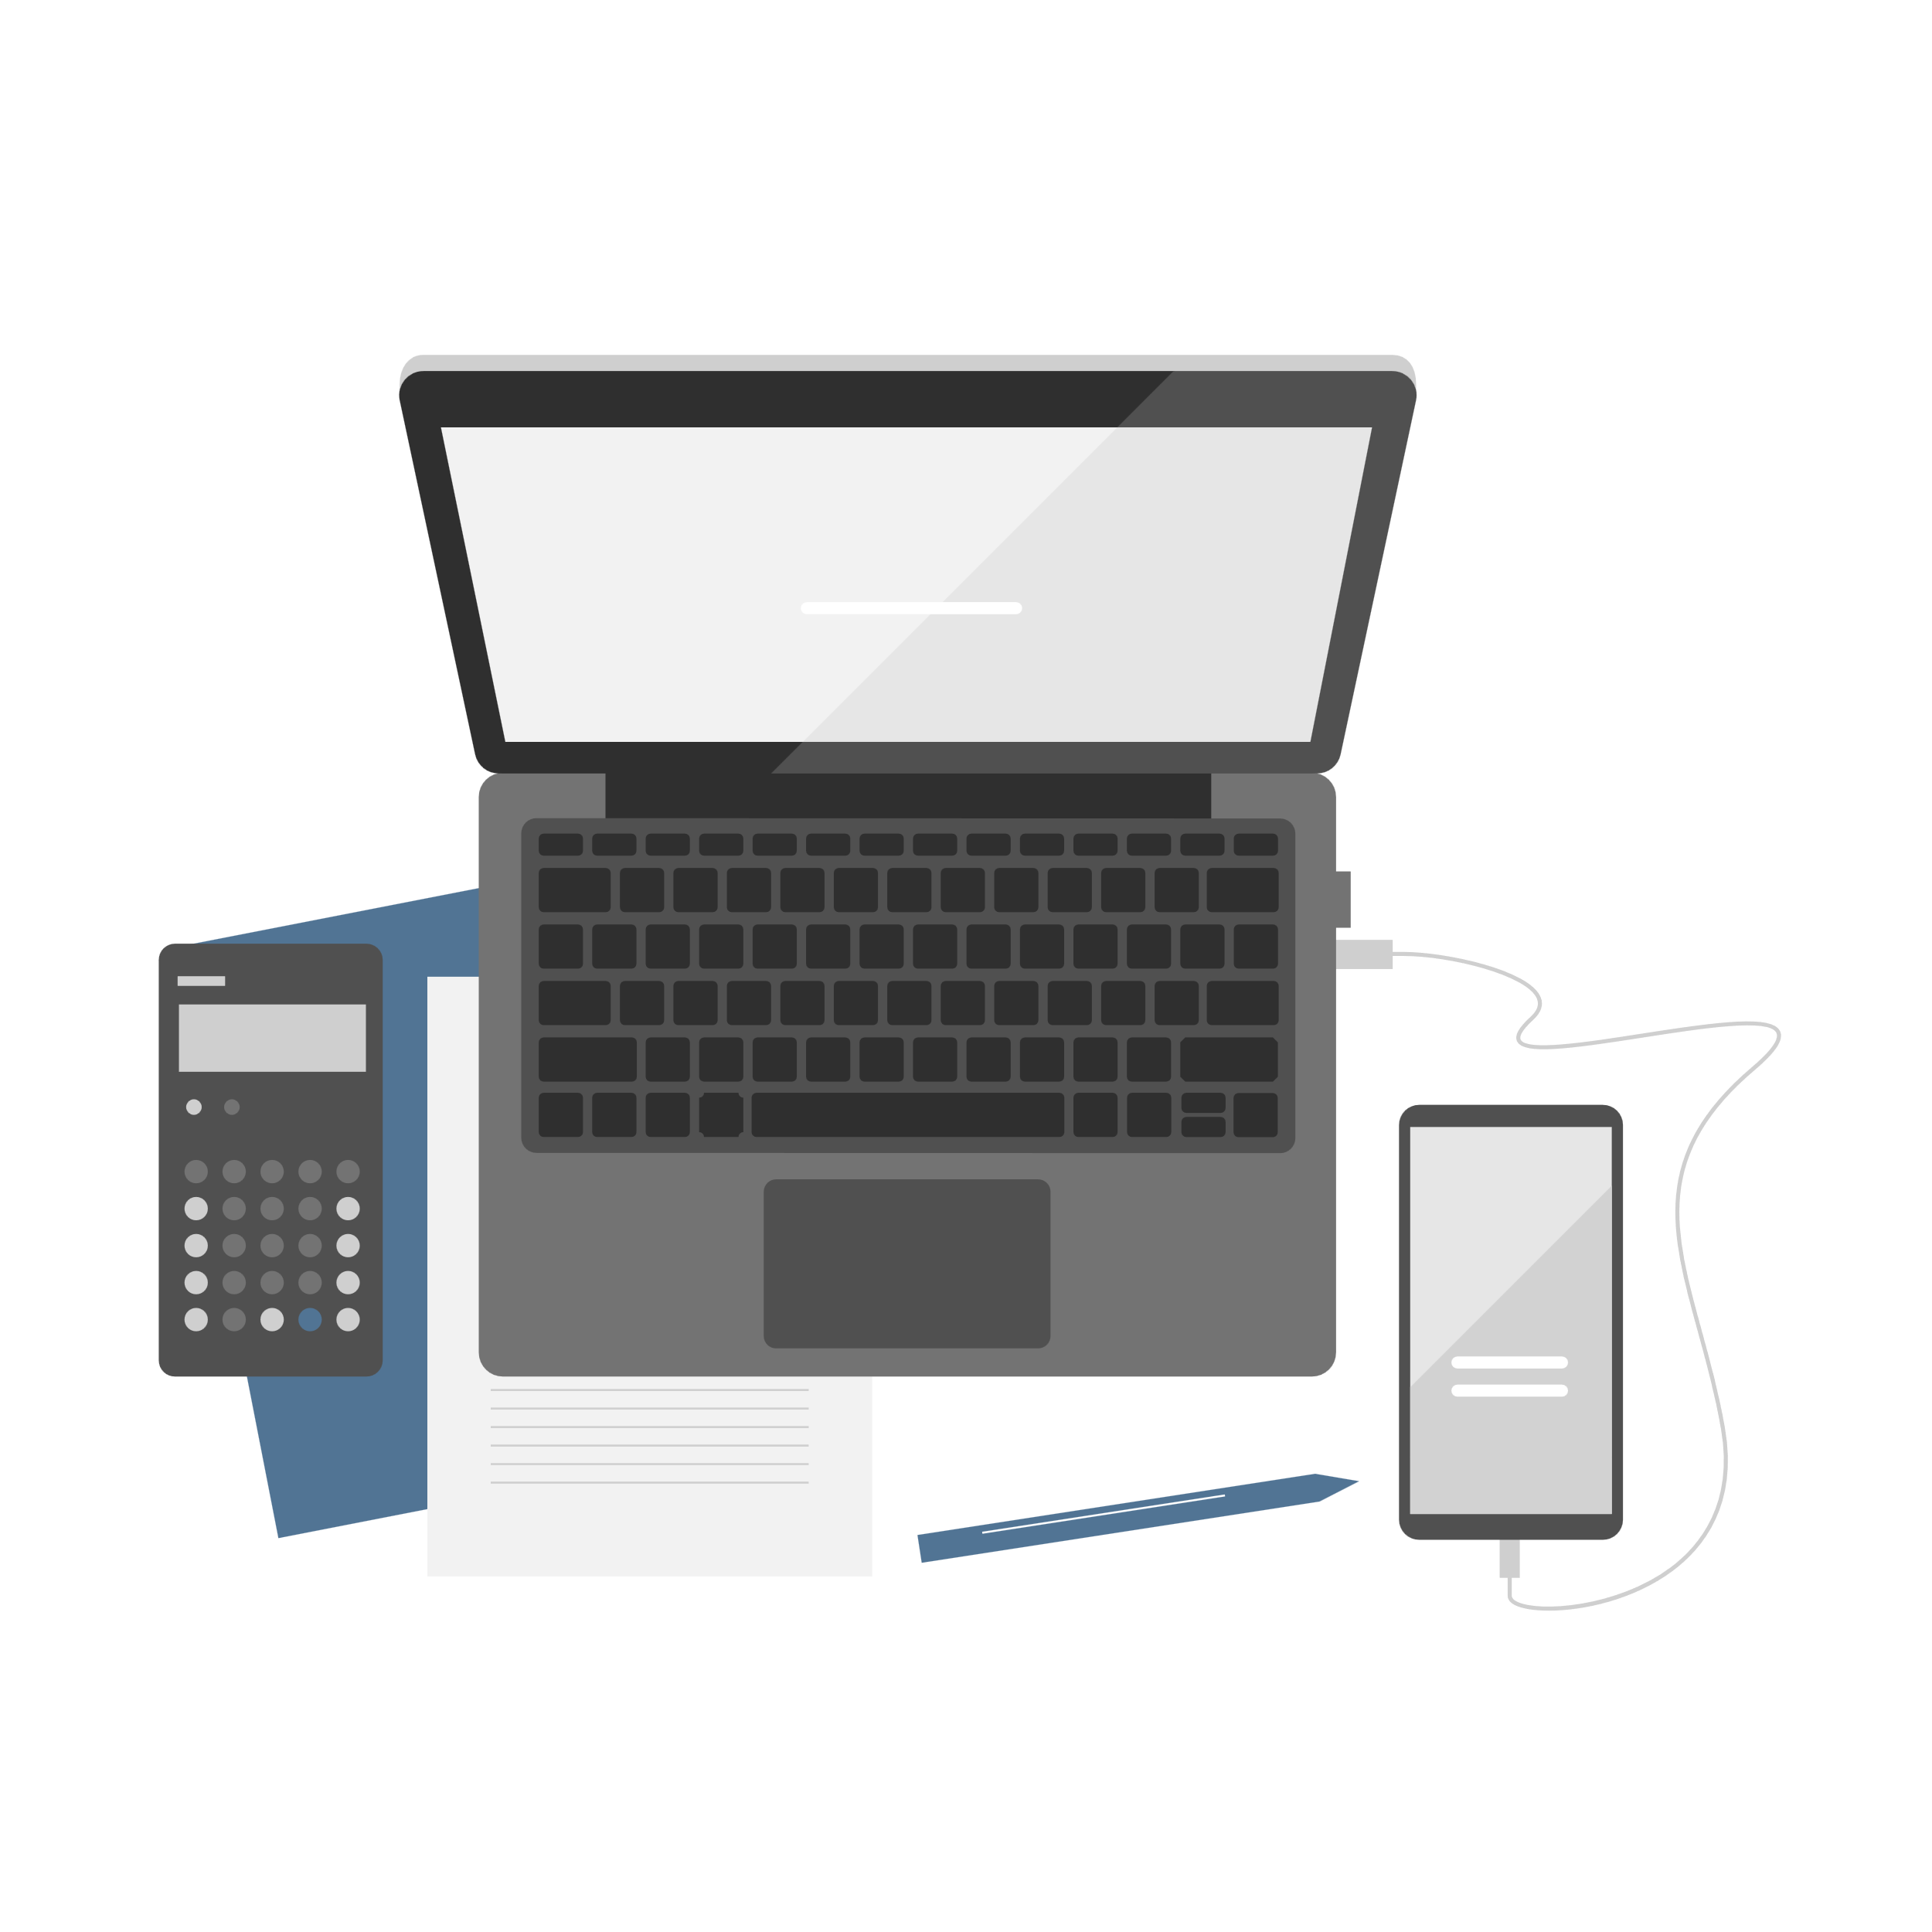
Operations and Tools
Create And Implement The Following Sound Effects:
Changing Amplitude
Shifting
Reversing
Compression & Expansion
Echoing
We Used The Following Tools:
Tikenter/Ttbootstrap - GUI Framework For Python
Wave - Open-source Science Computing Library
Numpy - Python Library For Large Computation Arrays
Matplotlib – For Plotting The Waveform
Scipy - Python Library For Manipulating Signals

Slide 4
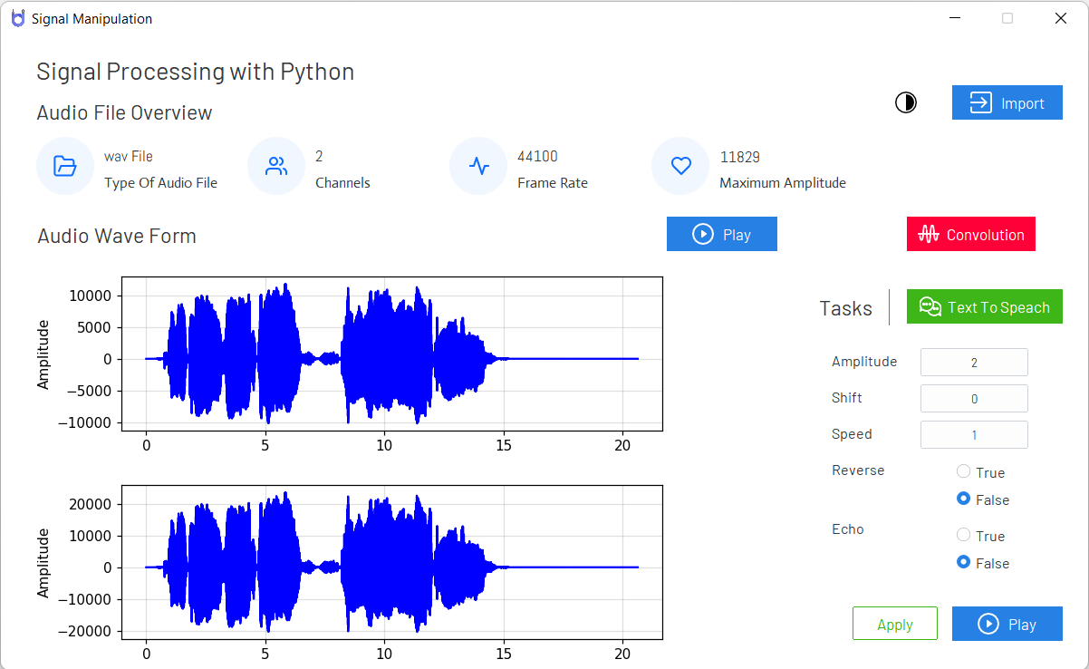
App Interface
Main GUI

Slide 5
SHOWCASING…

